Slide 1

Short-Term Solar Power Forecasting and Anomaly Detection
Group 4
Geronimo Welter Lapinig
Victor Rusu Sankruththian Senathirajah
Course: SCS 3253-093 — Machine Learning
Instructor: Dr. Sebastian Maurice

Slide 2
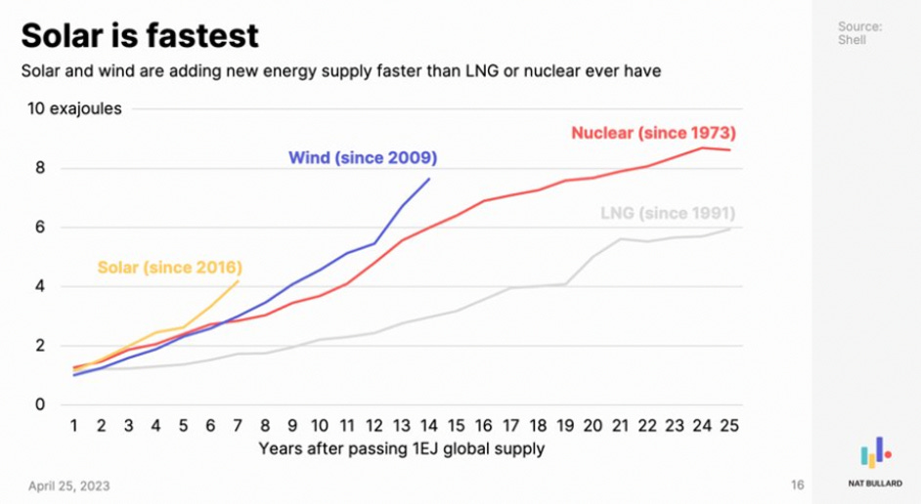
It’s importance…
It turns unpredictable sunlight into something utilities and grids can actually plan around.
By anticipating fluctuations and spotting irregular behavior early, it prevents energy waste, reduces downtime, and keeps renewable systems reliable.
In a world shifting toward clean energy, it’s the intelligence layer that makes solar power not just sustainable—but dependable.

Slide 3
Our Objective
Develop an accurate short-term forecasting model to predict solar power output using weather and historical PVDAQ data.
Implement anomaly detection to identify irregular system behavior and potential faults in real time.

Slide 4
Dataset Overview
PVDAQ-Systems-2105-and-2107
Contains time series data from PVDAQ Systems 2105 and 2107, published by the Open Energy Information (OpenEI) platform. The data includes various electrical and environmental measurements from two photovoltaic (PV) systems located in the United States.
It has been curated and preprocessed for use in anomaly detection tasks related to PV performance monitoring, fault detection, and forecasting. Each row represents a timestamped snapshot of system performance, including features such as power output, irradiance, temperature, and voltage.

Slide 5
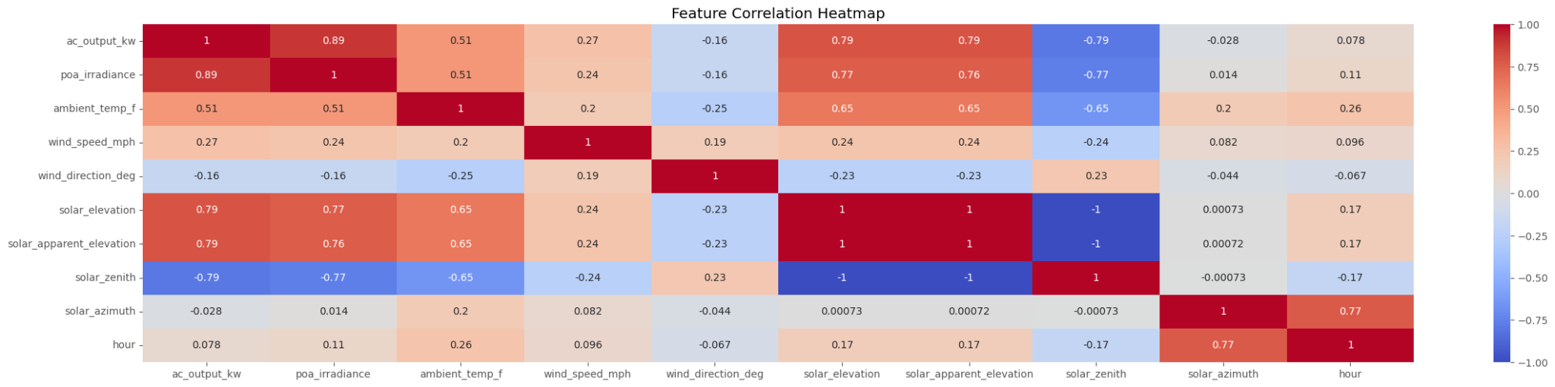
Correlation Analysis

Slide 6
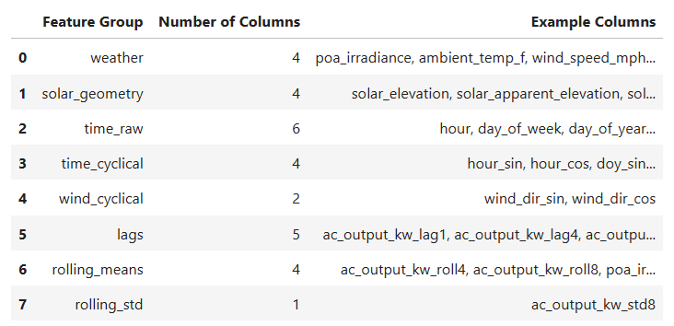
Structured Preprocessing and Feature Engineering
Feature Columns by Group
The model inputs are organized into meaningful groups.
This makes it easier to understand what type of information is being passed into the forecasting model and why each group matters.

Slide 7
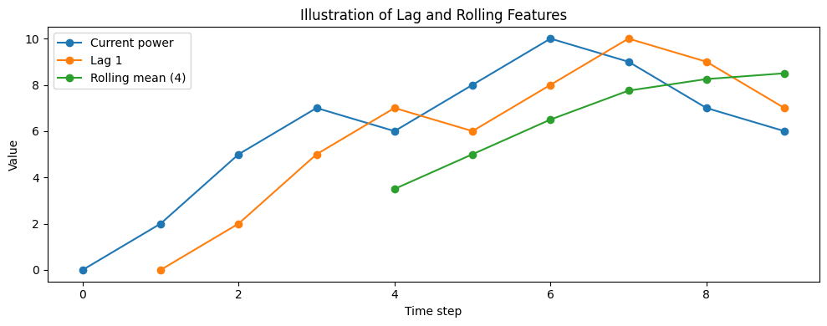
Why rolling features were added
Rolling features are useful because solar power can change quickly with cloud cover, irradiance variation, and local weather.
A rolling mean captures the short-term trend, while a rolling standard deviation highlights instability or rapid change.

Slide 8
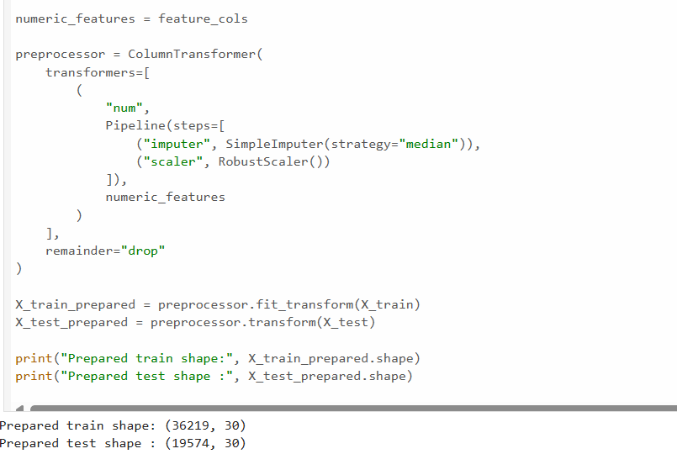
To ensure consistency and reproducibility in the modeling workflow, a reusable preprocessing pipeline was constructed to transform the engineered feature set into a model-ready format.
Preprocessing Pipeline
Notes:
Scaling is not strictly required, but creating a pipeline here gives the notebook better structure and makes it easy to compare future models.

Slide 9
Thank you for your attention!
You can check our work in details here:
github.com/gideonsys/ML-solar-forecast

